Slide 1
presentation
Bank of Baroda Hackathon 2024
Your Team Name : Packet Pirates
Your team bio : Sailing the seas of cybersecurity with precision and innovation.
Date : 30/06/2024

Slide 2
Problem Statement?
Develop an AI-powered chatbot and personal finance dashboard that offers personalized financial advice, educational content, and tailored marketing materials based on customer data, financial goals, and market conditions.
Why did you decide to solve this Problem statement?
High Market Demand : Increasing need for personalized financial tools.
Technological Feasibility: Advances in AI and data analytics.
Customer Engagement: Improves user satisfaction and loyalty.
Personal Passion: Interest in finance and technology.
Existing Gaps: Lack of comprehensive solutions in the market.

Slide 3
Pre-Requisite
What are the alternatives/competitive products for the problem you are solving?
Tata Mutual Fund : Offers a range of mutual funds for investment and financial planning solutions.
Mint : Helps users track expenses, manage budgets, and monitor financial accounts in one place.
You Need a Budget (YNAB) : Focuses on teaching users how to allocate money for specific purposes and manage it effectively.
Niyo : Offers digital banking services including savings accounts, current accounts, and basic investment products.
Betterment : Betterment is a robo-advisor that provides automated investment and financial planning services.

Slide 4
Tools or resources
Azure tools or resources which are likely to be used by you for the prototype, if your idea gets selected
Azure Bot Service
Azure Cognitive Services Azure Machine Learning Azure Data Lake Storage Azure SQL Database
Power BI
Azure Active Directory Azure Notification Hubs

Slide 5
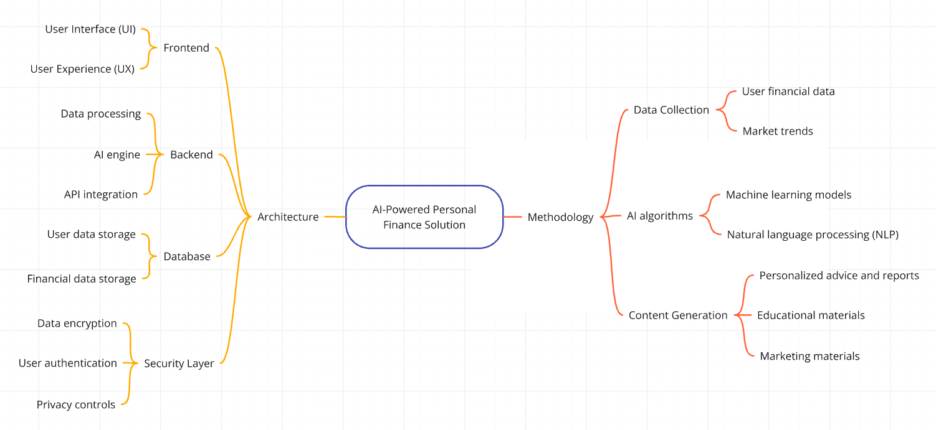
Any Supporting Functional Documents
Present your solution, talk about methodology, architecture & scalability

Slide 6
Key Differentiators & Adoption Plan
How is your solution better than alternatives and how do you plan to build adoption?
AI-driven Personalized Financial Advice: Custom recommendations based on user data and goals
Educational Content: Personalized resources to boost financial knowledge
Tailored Marketing Materials: Customized outreach to enhance customer interaction.
Comprehensive Financial Management: Holistic approach covering budgeting, savings, investments, and more.
Adoption Plan
1. Onboarding: Offer tutorials and support for easy setup.
2. Marketing: Use digital ads, partnerships, and content to attract users.
3. Engagement: Send personalized tips, notifications, and use gamification.
4. Metrics:Track user sign-ups, activity, and financial improvements.

Slide 7
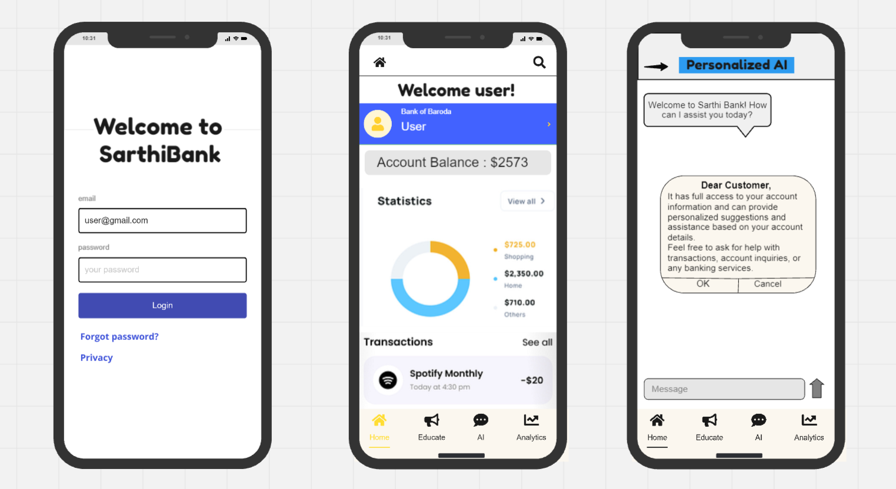
GitHub Repository Link & supporting diagrams, screenshots, if any
How far it can go?
Github Repository Link : https://github.com/sankalpramteke/Bank-of-baroda-hackathon-2024

Slide 8
Business Potential and Relevance
What are the business applications of the problem you are solving?
Personal Finance Management: Empowering individuals to manage their finances effectively.
Financial Planning and Advisory Services: Enhancing the services of financial advisors.
Banking and Financial Institutions: Providing value-added services to customers.
Employee Financial Wellness Programs: Supporting employee financial health and productivity. Educational Institutions: Teaching financial literacy to students.
.
UIY

Slide 9
Uniqueness of Approach and Solution
What is the unique aspects of the proposed idea?
Integrated AI Chatbot and Dashboard : Seamless interaction; competitors offer separately.
Personalized Content and Marketing : Tailored education and marketing; competitors provide generic resources.
Comprehensive Reporting : Detailed financial reports; competitors offer basic reporting.
Personalized financial advice : Tailoring financial advice to user goals, preferences, and real-time market conditions for informed decision-making.

Slide 10
User Experience
How will your idea enhance the user experience?
Personalization: Tailors advice to each user's financial situation and goals.
Accessibility: Provides anytime, anywhere access via a user-friendly chatbot interface.
Education: Offers tailored educational content to improve financial literacy.
Proactive Insights: Alerts users about important financial events and market changes.
Comprehensive Overview: Summarizes financial health with clear reports on savings and investments.
Engagement: Personalizes marketing to keep users informed and satisfied.

Slide 11
Scalability
How effectively can your solution be scaled to accommodate growth without compromising performance?
Cloud Infrastructure: Use of elastic cloud services (AWS/Azure) for dynamic resource allocation.
Microservices Architecture: Independent scaling of modular services.
Database Scaling: Implementation of sharding and caching for efficient data handling.
AI Model Optimization: Optimization of AI models for fast and scalable performance.
Security Measures: Scalable security solutions and regular audits.
User Experience Considerations: Progressive loading and responsive design for consistent performance.

Slide 12
Ease of Deployment and Maintenance
How simple is your solution to implement and maintain on an ongoing basis?
Implementation : Our solution aims to be straightforward to implement by leveraging modern AI and digital technologies, ensuring efficient deployment with minimal complexity.
Maintenance : Through robust architecture and streamlined development practices, ongoing maintenance is simplified, allowing for easy updates and enhancements to adapt to evolving user needs and market conditions.

Slide 13
Security Considerations
What measures are incorporated to ensure the security and integrity of your solution?
Secure Authentication and Authorization
Data Encryption
Monitoring and Logging
Regular Updates and Patch Management
Backup and Disaster Recovery
Network Security
Educate and Train Team Members
Penetration Testing and Vulnerability Assessments

Slide 14



Thank You
Sankalp Ramteke Kushal Kondalkar Tanishka Borade Rasika Borade

